Slide 1


Bot Detection and EDD Review
By Anastasia Bogacheva
Data Analyst Risk & Compliance

Slide 2


Bot Detection Strategy
Objective: Identify suspected bot registrations based on form submission patterns.
Key Indicators:
Very short average time between steps (e.g., < 20 seconds)
Low standard deviation in timing – consistent behavior = automation
Total registration time under 10 seconds
Techniques: SQL & Python Pandas Analysis

Slide 3

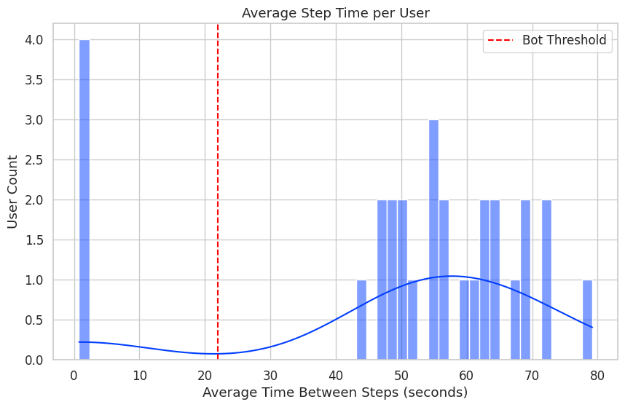
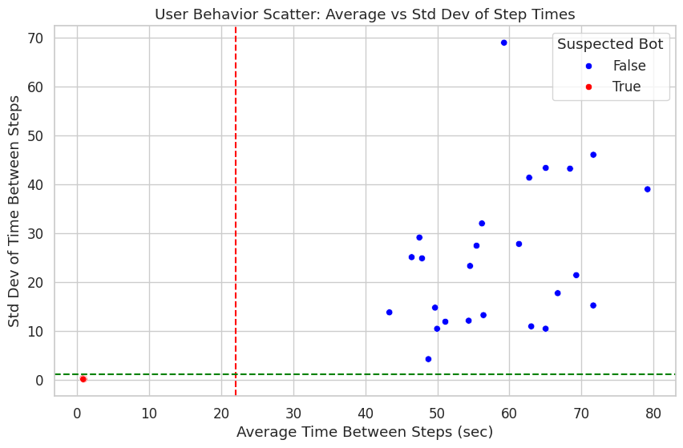
Findings – Suspected Bots
Detected Bots: 4 users
To detect suspected bots, we analyzed the average time between registration steps for each user.
Histogram: Average Step Time per User. The KDE curve (blue) illustrates the density of user behavior. The red dashed line at 22 seconds marks the IQR-based lower bound threshold for detecting anomalies.
2. Scatter Plot: Average Time vs Standard Deviation. This plot provides a two-dimensional view of user behavior by comparing: Average time between steps (X-axis) and Standard deviation of those times - how consistent the user was (Y-axis).
Together, these plots clearly highlight outliers who behave too quickly and consistently to be genuine users — strengthening our bot detection model both statistically and visually.
These users had:
Average time between 0.76 and 0.95 seconds
Very low standard deviation in timing (e.g., 0.05 – 0.23s)
All completed 3 steps in rapid, consistent succession.

Slide 4
EDD Timing Compliance
Policy: EDD (Enhanced Due Diligence procedure — a comprehensive review of customer information review) must occur before user loads $1000.
Approach:
Cumulative sum of transactions per user
Compare first time they cross $1000 vs review date
Flag users where review is after the threshold
Techniques: SQL & Python Pandas Analysis

Slide 5
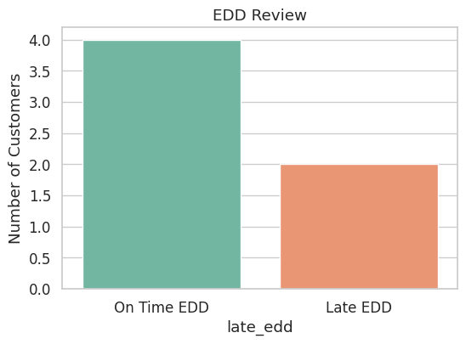
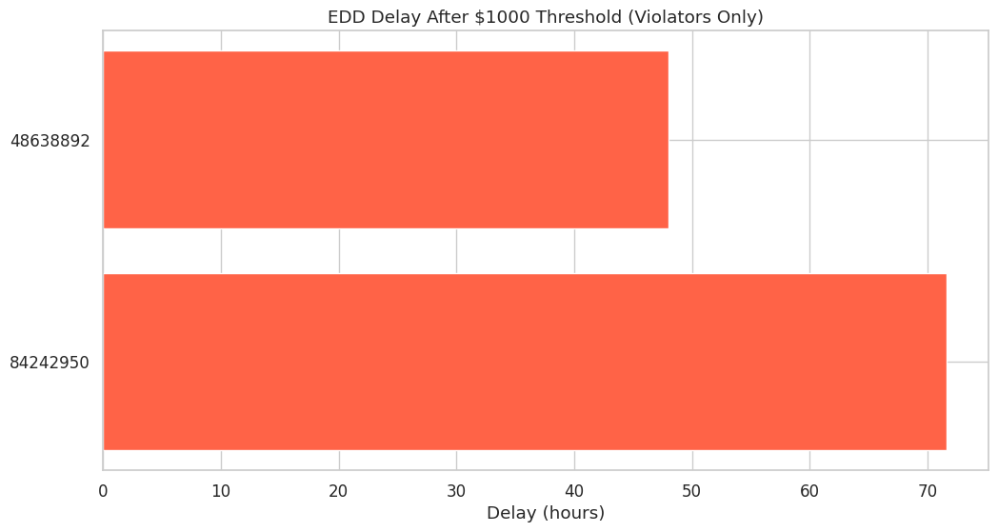
Findings – EDD Violations
Violators Identified: 2 users
Two customers were flagged as having their EDD review after crossing the $1000 threshold. They loaded over $1000 into their account before the EDD review was completed, which violates the policy.
Compliance Breakdown
4 users had their EDD review on time
2 users had late EDD reviews
EDD Delay Insight
The delay between crossing $1000 and EDD review ranged from a few hours to over a day, depending on the customer.

